Slide 1

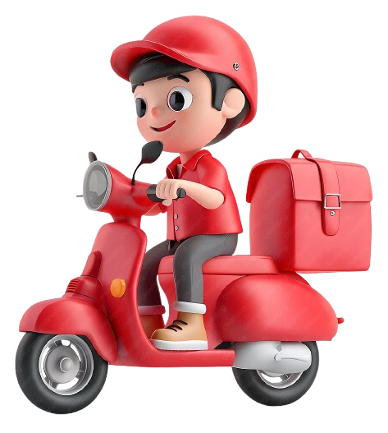
Zomato Analysis
Insights from Global Restaurant Data using Power BI, Tableau & Excel
Group 1
Aditi
Dayasagar H
Vamshi Kandula
Gurram Durga Pavani
Shreyas Pravin Kulkarni
Mohammed Farook Ahamed
Krushna Basveshwar Honrao

Slide 2
Project
Overview
Extensive Data Coverage
Multi-Platform Dashboards
Key Focus Areas
Analyzed over 9,500 restaurants across 15 countries and 141 cities.
Provides a broad and deep understanding of the global restaurant landscape.
Developed three distinct Power BI dashboards for pricing, delivery, and overall analysis.
Tableau and Excel dashboards for granular breakdowns.
Restaurant availability
Dynamic customer rating trends
Pricing behaviors
Accessibility of online delivery
Accessibility of table booking.

Slide 3
Global Restaurant Coverage
The comprehensive dataset includes a vast number of dining establishments, reflecting Zomato's extensive reach.
Insights are drawn from a diverse set of nations, offering a global perspective on restaurant trends.
The dataset captures an impressive variety of culinary types, showcasing global gastronomic diversity.
The overall average rating across all restaurants provides a general gauge of customer satisfaction.
9,551
15
141
1,825
2.89
Total Restaurants
Total Countries
Total Cities
Total Cuisines
Average Rating

Slide 4
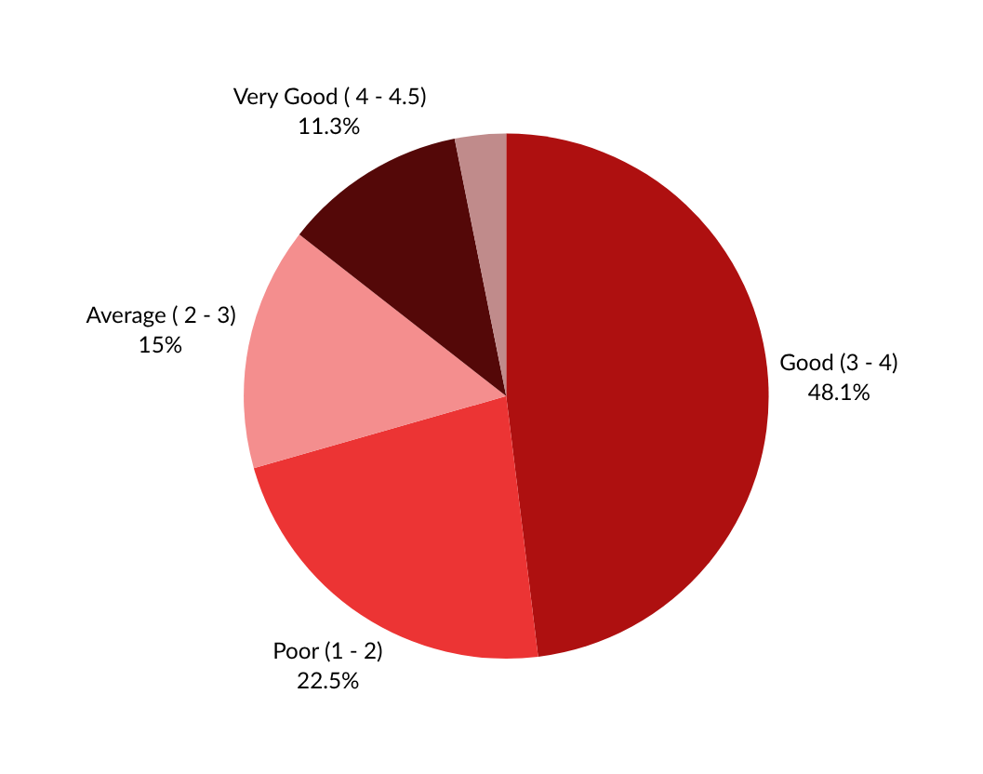
Excellent (>4.5)
3.2%
Customer Rating
Breakdown
The majority of restaurants fall into the "Good" category, highlighting a large volume of eateries providing satisfactory service.
However, a significant number "Poor" pointing to quality concerns.
The "Excellent" category is notably limited, indicating a gap in premium service offerings.

Slide 5
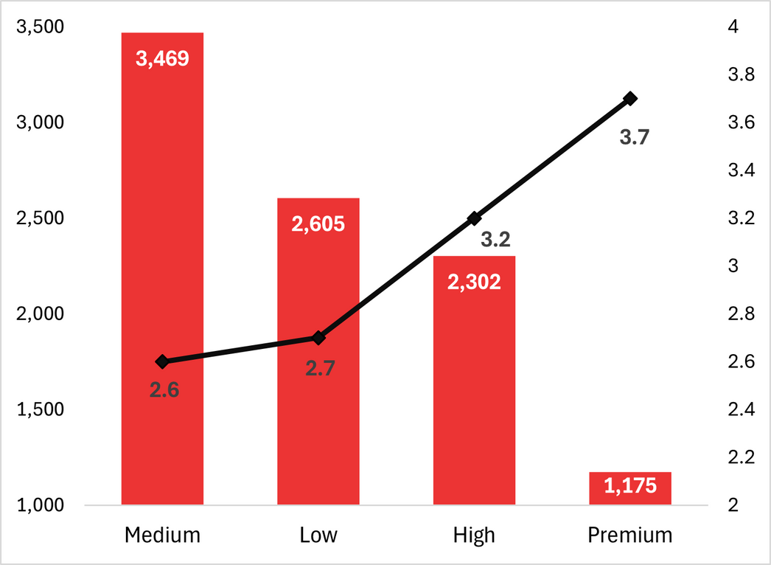
Price Bucket
Analysis
Dominant Price Segment: Most restaurants on Zomato fall within the Medium(₹250–₹500) range, reflecting the platform’s focus on the mid-range dining market that values both affordability and quality.
Premium Category Performance: Although the Premium (₹1000+) segment has the fewest listings, it records the highest average rating (3.7), indicating strong customer satisfaction and a growth opportunity for Zomato to expand its premium offerings.

Slide 6
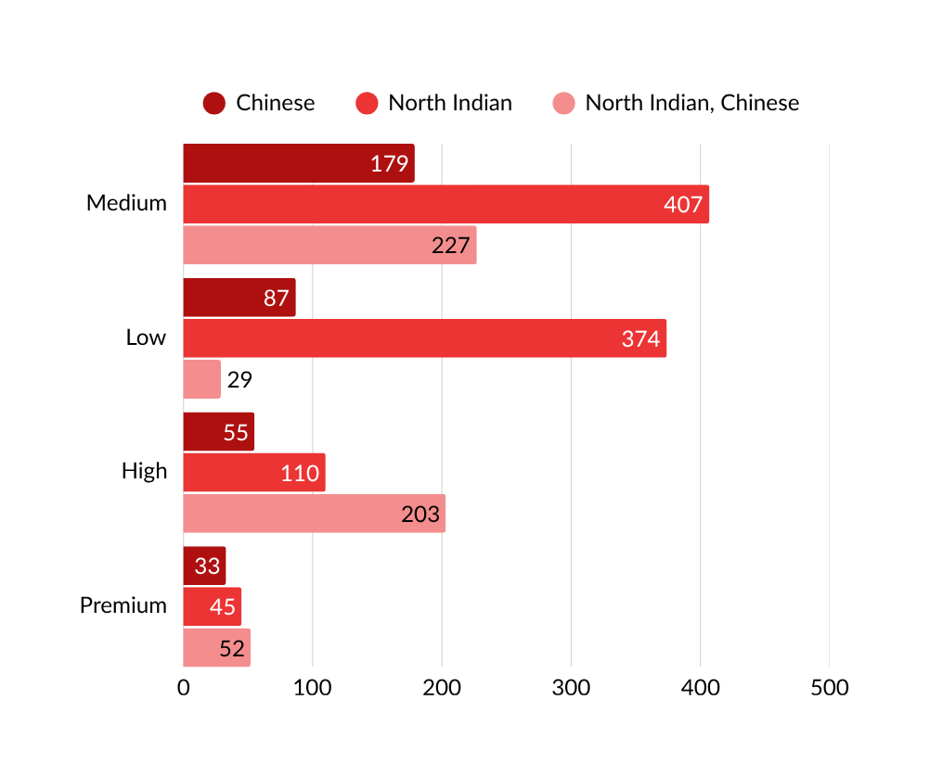
Cuisine Trends Across
Price Segments
Medium segment (₹250–₹500) dominates with the highest count for all three cuisines — North Indian (407) being the most prevalent overall.
North Indian + Chinese is highly popular in both Medium (227) and High (203) segments, showing strong multi-cuisine appeal in value and premium tiers.
In the Premium segment, even though volumes are low, all three cuisines are present, suggesting demand for curated, high-end dining experiences.
The Low segment sees heavy preference for North Indian (374) but limited presence of Chinese and multi-cuisine combinations, indicating narrower variety.

Slide 7
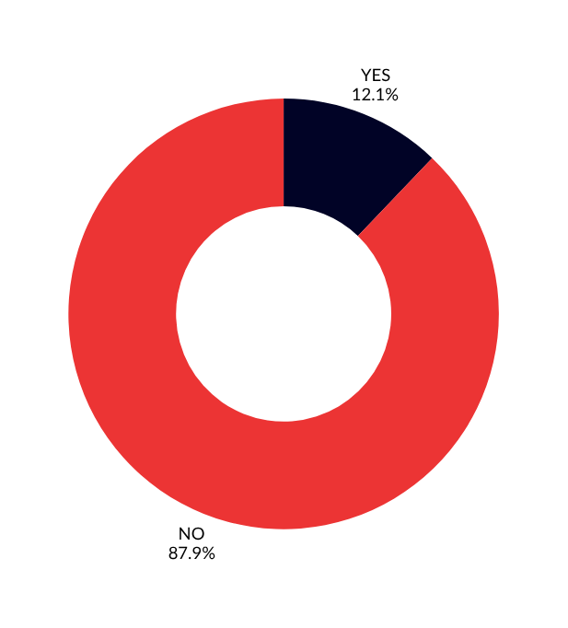
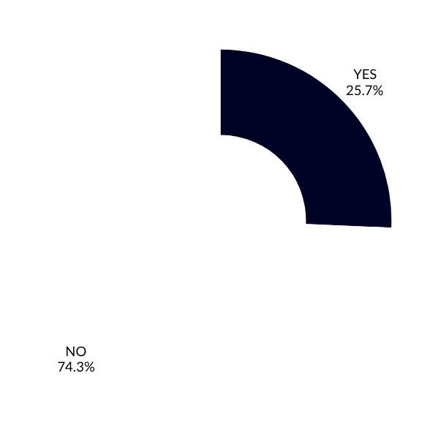
Table Availability
Online Delivery
Table booking is available in just 12.1% of restaurants. Key cities like New Delhi, Gurgaon, and Noida show higher adoption of delivery services, indicating regional disparities and areas for expansion.
Only 25.7% of restaurants offer online delivery. This represents a significant gap, especially in areas with high demand for convenience.

Slide 8
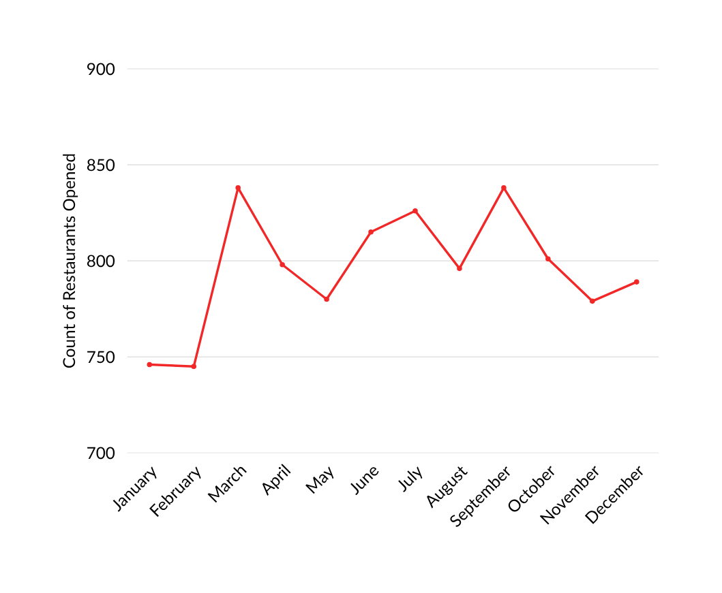
Monthly Trends
838
838
Consistent peaks in restaurant openings during March and September
This pattern could suggest seasonal influences, business planning cycles, or specific marketing campaigns driving new registrations
Understanding these peaks can help Zomato optimize its onboarding and support resources.
826
815
798
801
789
796
780
779
746
745

Slide 9
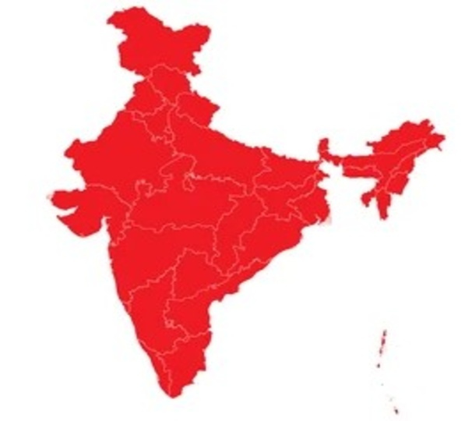
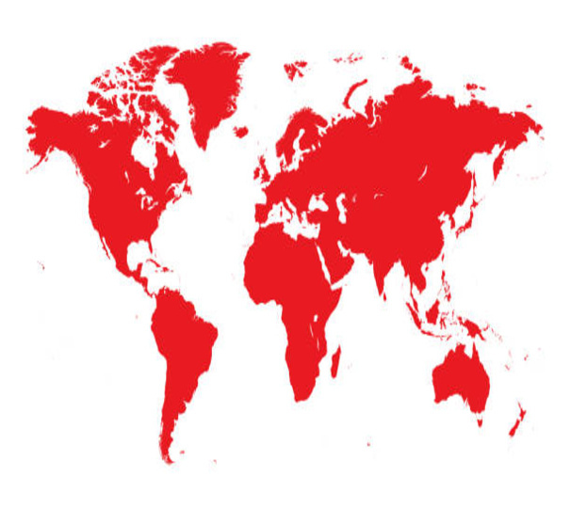
Dominance of Indian Metro Cities
The top three cities for restaurant listings are overwhelmingly from India: New Delhi (5,473), followed by Gurgaon and Noida
This concentration highlights Zomato's strong operational foothold and market saturation in these key Indian metropolitan areas
Minimal International Growth
In contrast to the Indian market, other cities and countries like South Africa and Australia show noticeably minimal growth in new restaurant listings
This indicates either lower market penetration, different local dining habits, or less aggressive expansion strategies in these regions
This presents a strategic question for Zomato regarding future international market development.

Slide 10






Insights
Restaurant Concentration
Service Gaps
Rating Trends
Over 90% of listings are from India, primarily New Delhi, Gurgaon, and Noida, reflecting Zomato’s core focus
Only 25.66% offer online delivery and 12.12% offer table booking—major expansion opportunity
Average rating 2.89; most in "Average" or "Poor" categories, signaling quality improvement need
Pricing Patterns
Cuisines & Cost
Regional Imbalance
Majority in the medium (₹250–₹500) range, but premium-priced outlets show higher satisfaction
Asian and Western cuisines dominate high-cost; Indian most common across all price segments
Tier 1 cities dominate; minimal presence in Tier 2/3 cities—potential market expansion
Monthly Trends
Peak activity in March and September, suggesting seasonality or campaign influence

Slide 11




Final Insights & Recommendations
Customer Experience
Premium Segment
Service Expansion
There's a strong opportunity to improve customer satisfaction, given that the average rating for most restaurants is below 3
Premium restaurants, though few, consistently deliver higher satisfaction, indicating an underserved market for high-quality dining experiences
Online delivery and table booking services are significantly underutilized, representing substantial untapped growth potential for Zomato and its partners
Market Penetration
Decision Making
Focus on expanding into Tier 2 and Tier 3 cities is crucial, as metro areas currently dominate the dataset, leaving vast potential markets unexplored
The developed dashboards provide robust tools for proactive decision-making in pricing strategies, market expansion initiatives, and optimizing service offerings.

Slide 12
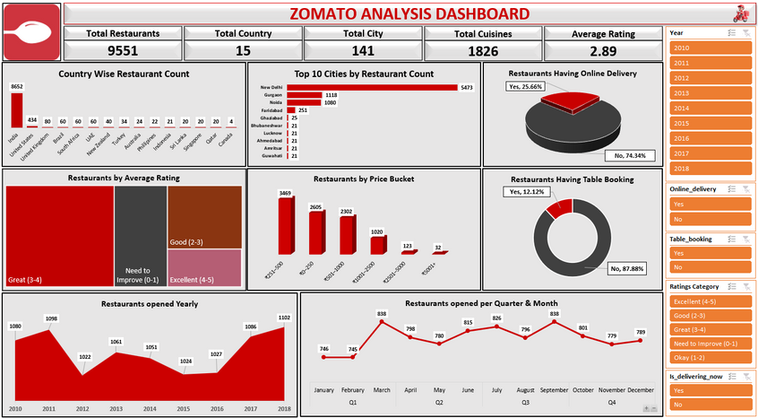
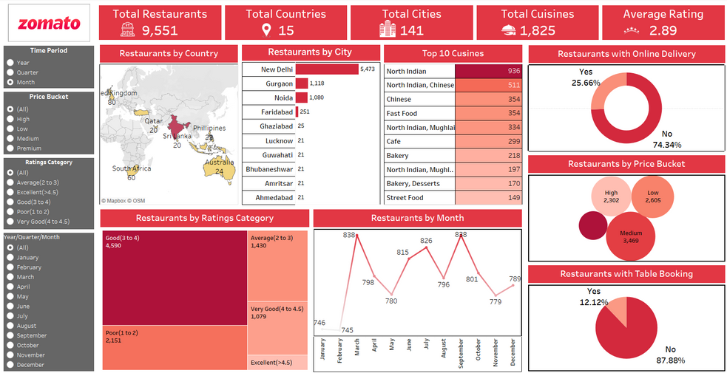
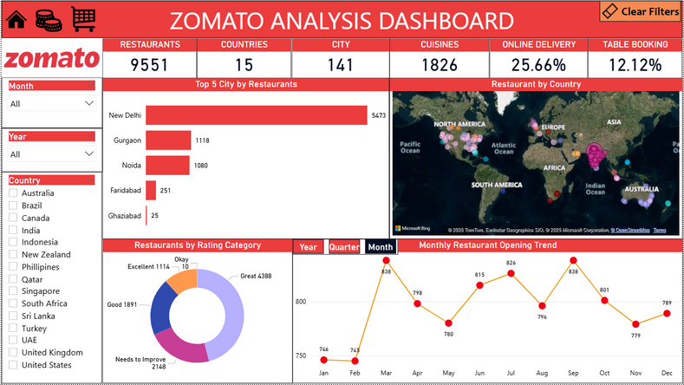
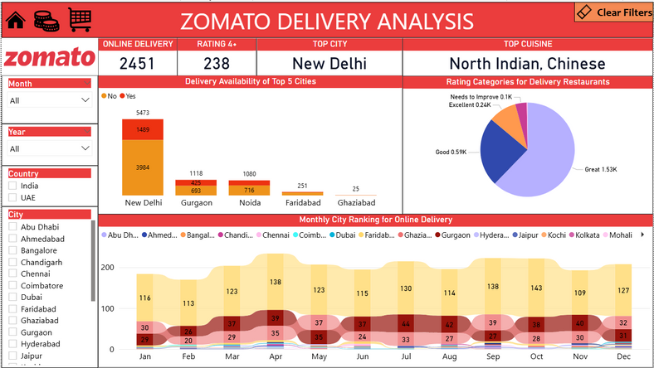
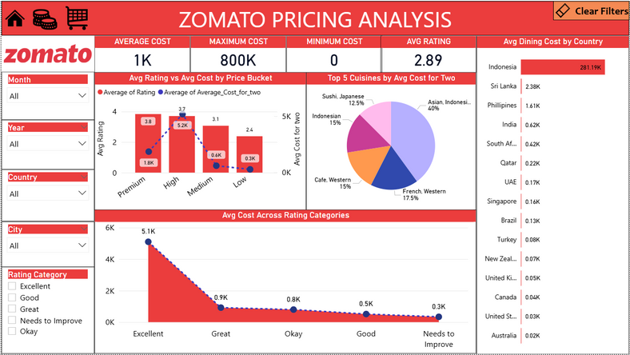
Dashboard’s
Excel
Tableau
Power BI

Slide 13
Thank You

